Slide 1
IMDB Movie Analysis
Project Overview :
This project focuses on analyzing an IMDB movie dataset to uncover the factors that influence a movie's success, defined by high IMDB ratings.
Objective : To identify key elements such as budget, genre, actors, directors, and other factors that contribute to higher movie ratings on IMDB.
GOAL : Provide actionable insights for movie producers, directors, and investors to make informed decisions about future film projects
EXCEL SHEET⬇️
Excel Sheet (Click Here)

Slide 2
Approach and Execution
Data Collection & Cleaning:
The dataset was cleaned by handling missing values, converting data types, and removing duplicates.
Exploratory Data Analysis (EDA):
Analyzed relationships between different factors like budget, genre, director, and IMDB ratings. Various visualizations were created using tools like histograms, bar charts, and scatter plots.
Techniques Used:
Correlation matrix to find relationships between variables.
Regression analysis to determine which factors have the most influence on IMDB ratings.

Slide 3
Tech- Stack Used
Microsoft Excel 2016:
Data Cleaning: Used to handle missing data, remove duplicates, and convert data types for consistency.
Data Analysis:
Applied filters, pivot tables, and conditional formatting to explore relationships between variables like budget, ratings, and genres.
Utilized Excel formulas (such as SUMIF, AVERAGEIF, VLOOKUP) for calculations and summaries.
Visualizations: Created charts such as bar graphs, scatter plots, and pie charts to visualize trends and insights in the dataset.
Trend Analysis: Used Excel’s built-in functions for trend lines and regression to analyze how factors like budget, cast, and director influence IMDB ratings.

Slide 4
Insights
Top Factors for Success: High Budget and Popular Cast/Directors lead to higher ratings. Trends Identified: Action/Adventure genres perform better in ratings. Newer films slightly outperform older ones in average ratings. Conclusion: The analysis provides valuable insights into the factors influencing movie success, helping stakeholders make informed decisions.

Slide 5
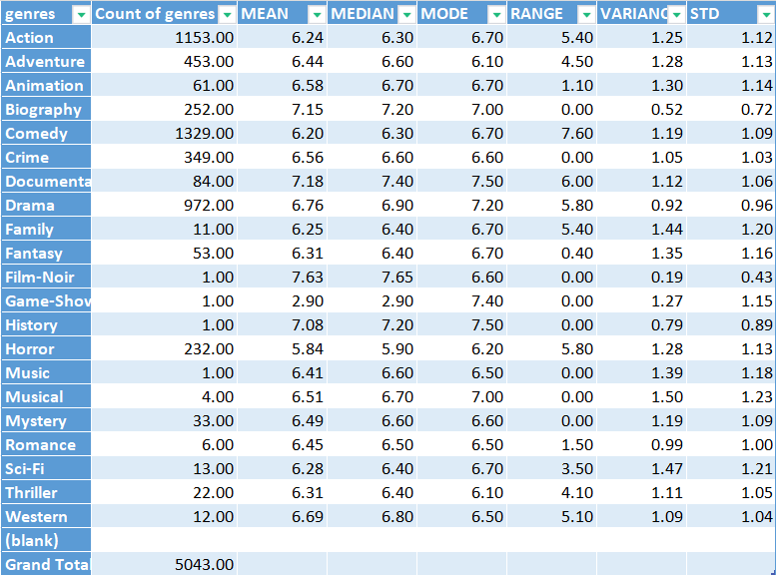
RESULTS
A. Movie Genre Analysis: Analyze the distribution of movie genres and their impact on the IMDB score.

Slide 6
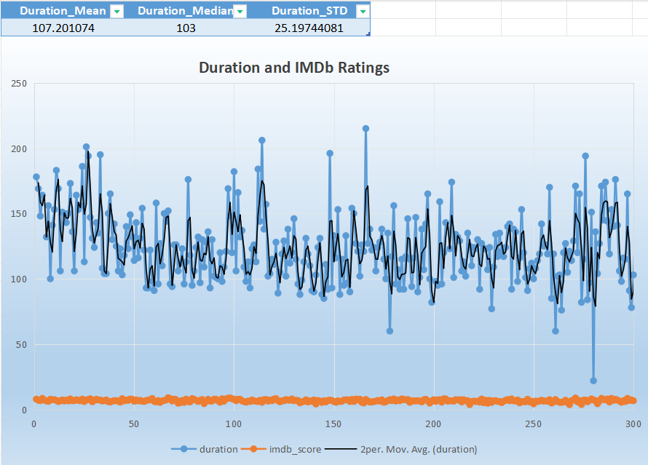
RESULTS :
B. Movie Duration Analysis:Analyze the distribution of movie durations and its impact on the IMDB score.

Slide 7
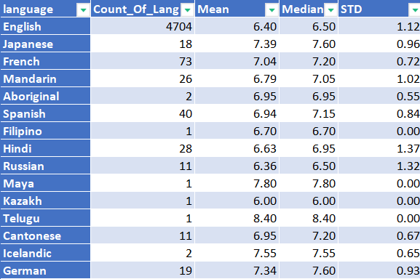
Results
C. Language Analysis: Situation: Examine the distribution of movies based on their language.
More In Excel Sheet...

Slide 8
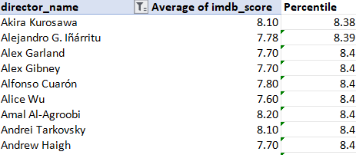
Results
D. Director Analysis: Influence of directors on movie ratings.

Slide 9
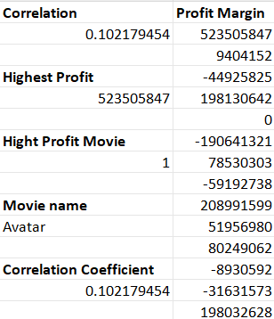
Results
E. Budget Analysis: Explore the relationship between movie budgets and their financial success.

